Slide 1



INSTAGRAM PPT TEMPLATE
인스타그램 PPT템플릿 :: 혜링이블로그
[혜링이블로그] PPT템플릿 무료나눔 제42탄

Slide 2
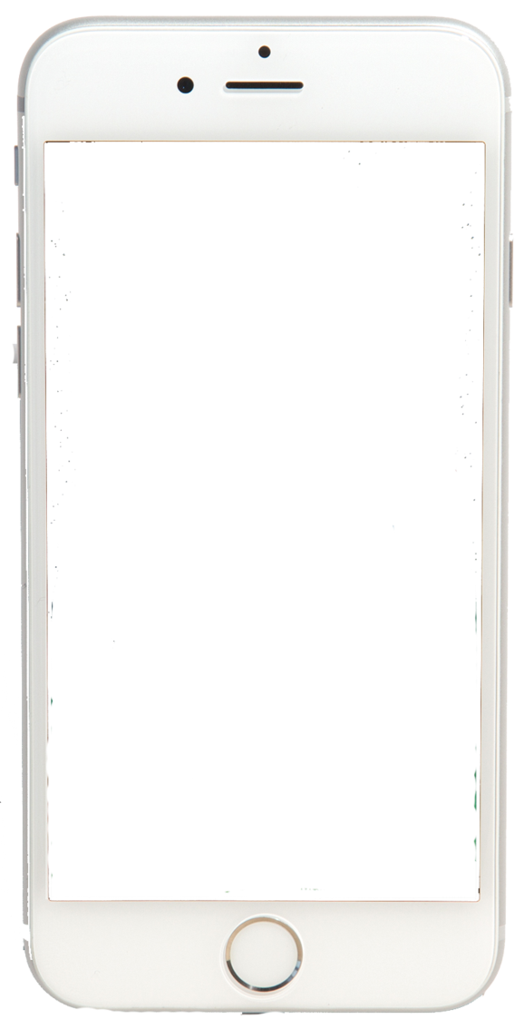




index
목차
ID
1. Write a Text Here. ■□□□
Password
Login
2. Write a Text Here. □■□□
3. Write a Text Here. □□■□
4. Write a Text Here. □□□■

Slide 3


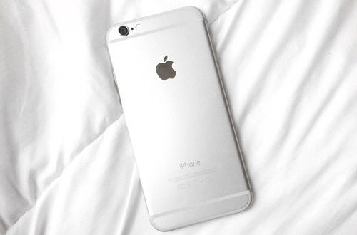
1. Write a text Here.
‘ TiTle ’
Write a text here.
‘ TiTle ’
Write a text here.
‘ TiTle ’
Write a text here.
‘ TiTle ’
Write a text here.
‘ TiTle ’
Write a text here.
‘ TiTle ’
Write a text here.

Slide 4
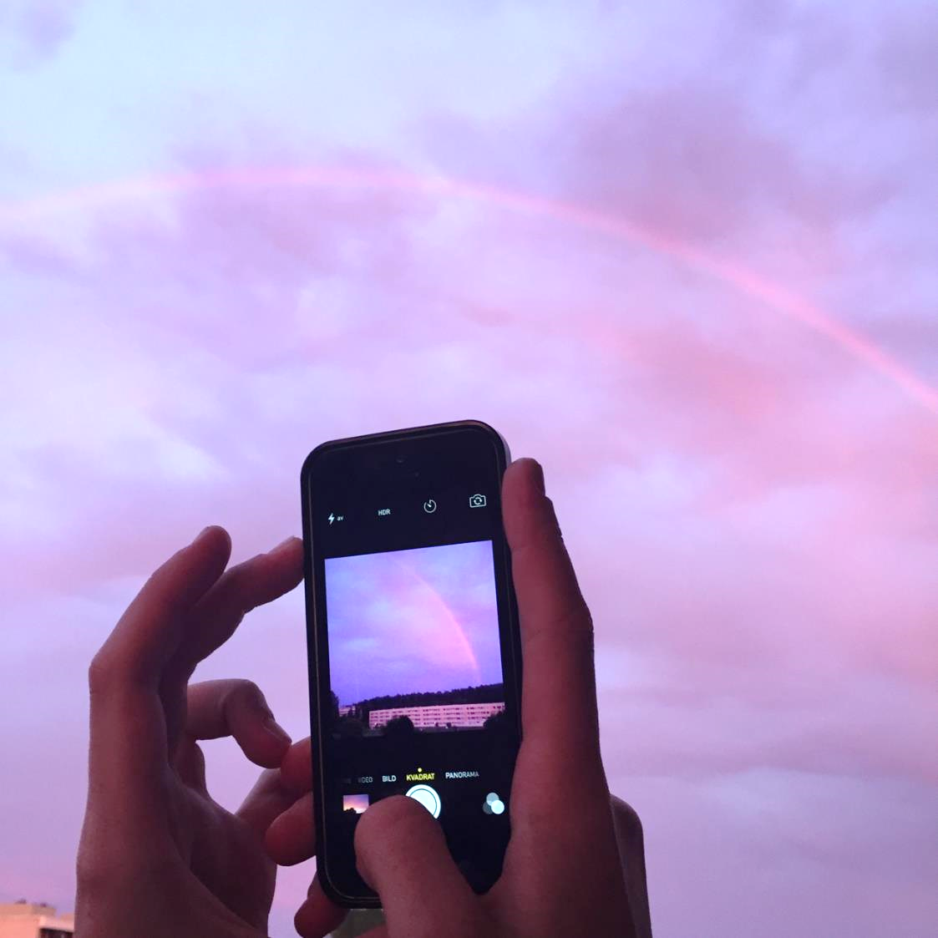
1. Write a text Here.
무료PPT템플릿은? 혜링이블로그에서!

Slide 5



2. Write a text Here.
Write a Text Here
Facebook
- Write a text here.
- Write a text here.
Instagram
- Write a text here.
- Write a text here.
Twitter
- Write a text here.
- Write a text here.
* 위 수치는 임의로 지정한 것입니다.

Slide 6
2. Write a text Here.
- The PPT was created with Microsoft Power Point 2016.
Photo
Photo

Slide 7

3. Write a text Here.
PHOTO
폰트를 설치 하신 뒤
파워포인트를 껐다 켜야
설치된 폰트가 적용됩니다.

Slide 8



3. Write a text Here.
Photo
Photo
Photo

Slide 9


4. Write a text Here.
Project : Write a Text Here.
▶ Write a Text here.
Power Point Ver. : Microsoft Power Point 2016
Free Power Point Template.
Write a Text Here. And Photo
무료PPT템플릿 다운 : 혜링이블로그

Slide 10
4. Write a text Here.
▶ Write a Text here
Write a Text Here.
Write a Text Here.
10%
Percentage
User
[date.]
- Write a Text Here.
- Write a Text Here.

Slide 11
INSTAGRAM PPT TEMPLATE
Thank You. Any Questions?
[혜링이블로그] PPT템플릿 무료나눔 제42탄

Slide 12
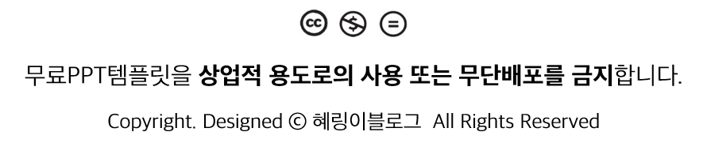
(해당 슬라이드는 지우고 사용하세요)

